Slide 1

Commercial Asset Visibility Repairables Portal (CAV-RP) Training
Presented to:
2024 San Diego CAV-RP Live Training Event
Presented by:
Caitlyn Szymczak and Keith J. Miller N85
READY. RESOURCEFUL. RESPONSIVE.

Slide 2
Introduction
Objectives:
  Review the importance of CAV Repairables Portal (CAV-RP)
  Review the process of reporting NAVSUP Material
  Understand the common repair transactions and reports
Be sure you know your facility’s:
  Routing Identifier Code (RIC)
  Department of Defense Activity Address Code (DoDAAC)
  NAVSUP CAV-RP Analyst
CAV-RP Statement of Work (SOW): https://www.navsup.navy.mil/NAVSUP-Enterprise/NAVSUP-Weapon-Systems-Support/Provisions-Instructions-and-Contract/
READY. RESOURCEFUL. RESPONSIVE.
Notes:
RIC three character identifier for your site, eg Q12
DoDAAC 6 character identifier for your site
The CAV SOW has been updated to encompass CAV-RP

Slide 3
What is Commercial Asset Visibility Repairables Portal(CAV-RP)?
CAV-RP Overview
CAV-RP is a Real-time Web based application, providing visibility of location, condition, and quantity of repairable assets to NAVSUP
The application is used by the repair vendor to report assets received, update the condition code of assets, and ship the assets back to a Fleet Activity or Defense Depot
How is CAV-RP Data Used?
Real-time: providing visibility of location, condition, and quantity of repairable assets
Provides NAVSUP Item Managers the ability to monitor asset levels and repair turn-around time
Assists NAVSUP Contract Managers in Buy/Repair decisions
Serial Number Tracking of specific units from manufacture to disposal
The timely and accurate reporting is crucial for achieving effective fleet readiness.
READY. RESOURCEFUL. RESPONSIVE.

Slide 4
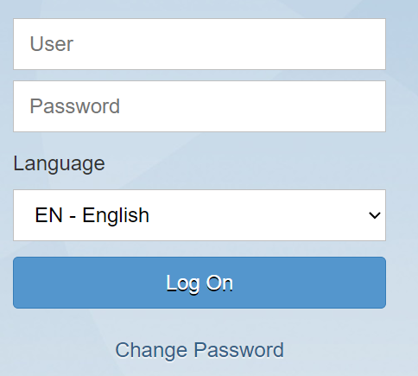
Accessing CAV-RP
Important Info
After your SAAR is processed and approved, you will be given access to CAV-RP
Log Into CAV-RP with the following link:
https://external-portal.erp.navy.mil/
We suggest setting calendar reminder to log in every two weeks
You will not need a username and password to access CAV-RP.
If you receive the above screen when logging in reach out to your CAV-RP Analyst for assistance.
READY. RESOURCEFUL. RESPONSIVE.
Notes:
You will receive an email notification once your account is established. You will have 7 days from that notification to do an initial login or your account will be locked.
https://public.cyber.mil/training/cyber-awareness-challenge/

Slide 5
Terminology change between CAV and CAV RP
CAV Term | CAV-RP Term
NIIN | Material
Source Document Number | DD1348 MILS Inbound
Shipment Document Number | DD1348 MILS Outbound
Ship to DoDAAC | SUPPADD
MMD Report | Inventory labels
SRA Requisition | GFM Creation
Consume Shipment | GFM Goods Issue

Slide 6
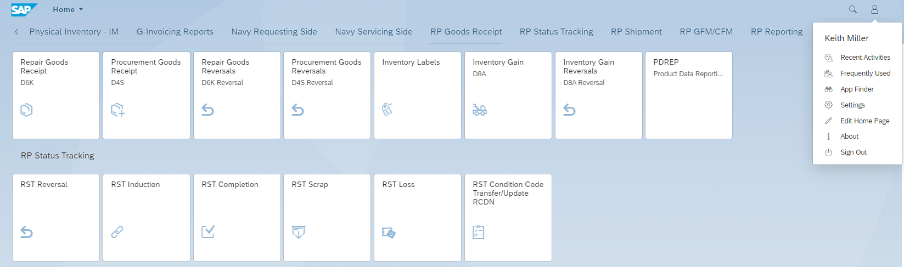

CAV-RP Main Page
You can jump to specific reporting categories using the top row
The tiles can be rearranged by dragging them left or right
Launch multiple CAV-RP sessions at one time
You can further customize your settings using the profile icon in the top right corner.
READY. RESOURCEFUL. RESPONSIVE.

Slide 7
Receiving Assets
  Due in Report- found down in RP reporting section. search and receive material shipped to your site with Open Stock in Transit(SIT report).
  RP Goods Receipt - Repair goods receipt and reversal, Procurement receipt and reversal, inventory gain and reversal
READY. RESOURCEFUL. RESPONSIVE.
Notes:
The Due in report is found in the RP Reporting Section.
The remaining receipt functions are found in the RP Goods Receipt section.

Slide 8
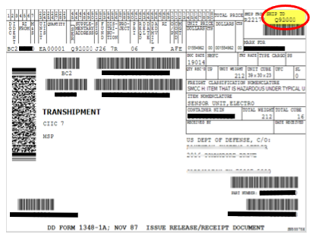
DD1348 Review
Provide signature, date, and legibly printed (or stamped) name
READY. RESOURCEFUL. RESPONSIVE.
Notes:
When posting a good receipt using a DD-1348 make sure it has your DoDAAC in box 3 (top-right corner) of the DD-1348. If you do not receive paperwork or correct paperwork please reach out to your CAV-RP analyst with any documentation you did receive, for example shipping labels, NIIN/serial number, tracking information, date it was delivered, etc. This will help them locate the proper DD-1348. If they are unable to locate the proper DD-1348 they will provide you with a No Paperwork document number to use to receive the material into CAV-RP.

Slide 9
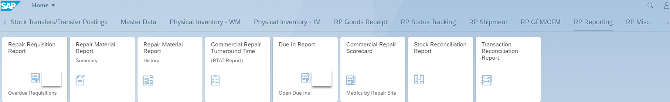
Due in report
Found down in RP reporting section
All open SIT that is being shipped to your facility
Reduces manual entry and possible errors
Notes:
The due in report is located on the RP reporting category on the main page. This is where you can pull a report of all assets shipped to you that have not been received in CAV-RP yet.

Slide 10
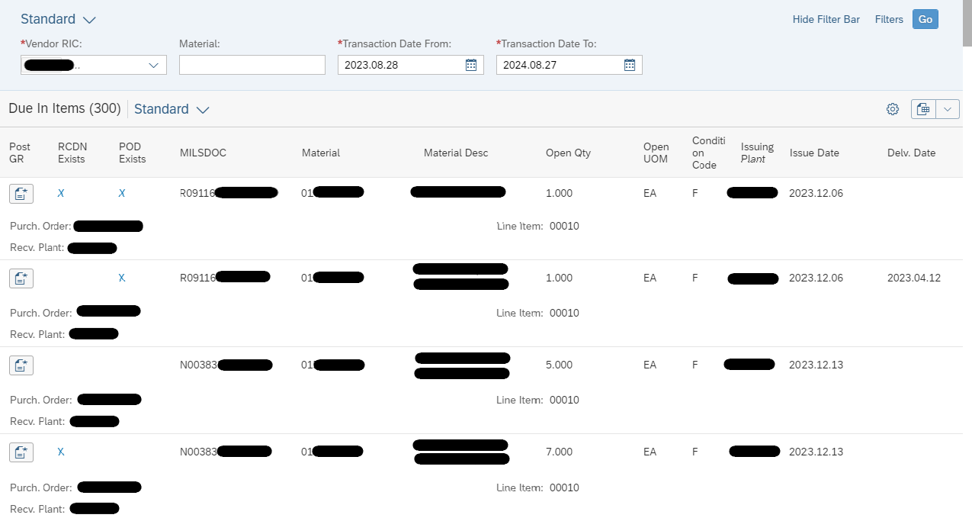
Due in report
Notes:
This is only used to post receipts if the asset matches the DD1348 exactly for NIIN, Condition Code, etc. With the due in report you can receive a partial quantity for (instance 1 of 5) however, you cannot receive material in excess of the shipped quantity.
You can enter your RIC, NIIN and click Go. Note the “POD Exists” field that indicates if the asset is shown as delivered to your facility. If this is blank it may indicate that the asset is still in transit. You can click on the “X” to view tracking and signature information.
The RCDN Exists indicator will populate when an RCDN is identified in CAV-RP. This may indicate a partial receipt and still needs further receipts posted to close SIT. When you click on the X indicator for RCDN Exists it will take you to the CAV-RP material history report for those RCDNs. There have been instances in which CAV-RP picks up the outgoing RCDN from the site and registers it as RCDN Exists. We have submitted a heat-ticket to address that instance HT#101098504.
You can also click the Cog wheel and add columns such as serial number and tracking information as well as rearrange the report columns and export to Excel.
After you find the record that matches your DD1348 and click on the Post GR icon.
Click the Mils Doc number line on the next screen.
Enter SN, location, and reference if needed. Also don’t forget to update the Action date to reflect physical date of delivery.

Slide 11
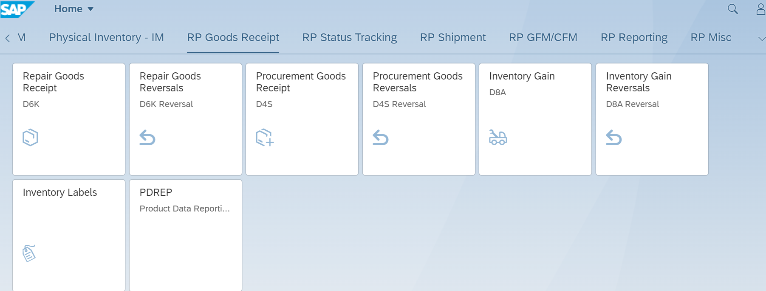
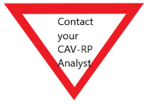
Repair Goods Receipt
RP Goods Receipt
Choose Repair Good Receipt for the following:
  Receiving F condition material for repair
  Receiving J condition Misdirected material for return to an ATAC Hub
Choose Procurement goods receipt (D4S) if part being received is a new procurement asset via DD250
Only use Inventory Gain when instructed by your CAV-RP Analyst
Choose Inventory Labels to print an inventory Label (previously MMD) or to update a serial number
Transactions must be recorded into CAV-RP within 7 business days of the reportable event
READY. RESOURCEFUL. RESPONSIVE.
Notes:
Use Repair Goods receipt is used to receive material on a DD-1348 or if instructed by your CAV-RP analyst to receive on a “No Paperwork” document. Goods Receipt Reversal is used to reverse a receipt posted using Repair Goods Receipt. Reversing goods receipts that are greater than 30 days old will need to be approved by your CAV-RP analyst. The asset will remain in your active CAV-RP inventory until the reversal is approved. The CAV-RP analyst will automatically receive a notification for this approval. To expedite the reversal approval the repair vendor can reach out to their CAV-RP analyst with details on why they are posting a goods receipt reversal that is greater than 30 days old.
Use Procurement Goods Receipt when you are receiving newly procured material on a DD250.
Only use Inventory Gain when instructed by your CAV-RP Analyst.
Use inventory labels to update a serial number, reference number, and/or location of an asset. You can update serial numbers for assets in any condition code except for H condition and those that are shipped.

Slide 12
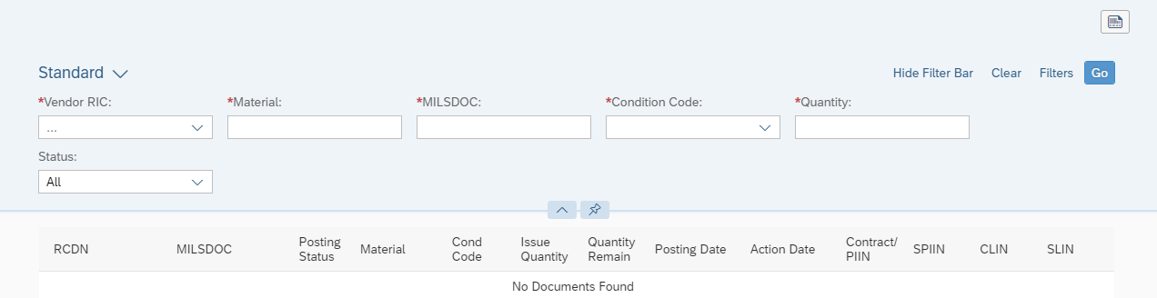
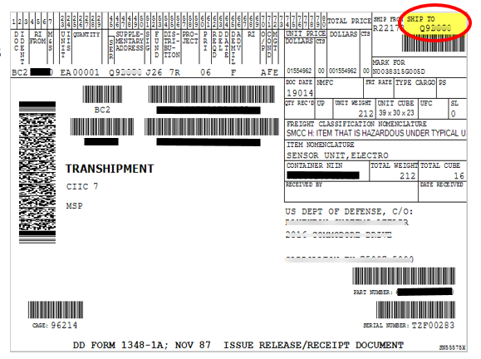
Repair Goods Receipt
Fill in all required fields marked by the *
Most of the information can come directly from the DD1348. Receive the NIIN and Quantity you physically received.
  Vendor RIC is your site RIC
  Material is the NIIN
  If the NIIN cannot be identified use MDJ111111
  Document Number
    Usually will begin with: N00383 – PHIL N00104 – MECH
    Or a fleet DoDAAC
  Condition Code (see next slide for more info)
  Quantity
READY. RESOURCEFUL. RESPONSIVE.
Notes:
Most of the information can come directly from the DD1348, however if there is any variance between the DD-1348 and the physical asset receive what is physically on the asset.
To receive the material using Goods Receipt Enter the information below and click Go:
-Enter in your RIC as the vendor RIC
-Material is the NIIN (Block 25 on the DD1348)
-MILSDOC is the document number (Block 24 on the DD1348)
-Condition Code (Block 71 on top of the DD1348)
-Quantity (Block 25-29 on top of the DD1348)
You will notice there are a number of condition codes to choose from when receiving material. Assets are typically received in A, F, J, or L condition. If you feel you need to use one of the other condition codes please work with your CAV-RP analyst and the NAVSUP item manager (Planner) to ensure all parties are aligned on the situation regarding those assets. Do not receive assets in as M or G condition as these require a contract/CLIN to accompany the transaction.
Condition Code:
A - Repair is completed and material is ready for issue without qualification
B - Repair is completed and material is ready for issue with qualification
C - Repair is completed and material is priority ready for issue
D - Repair is completed and material requires test or modification
E - Teardown and Evaluation
F - Carcass is not currently being worked and is not ready for issue
H - Carcass is beyond repair or beyond economic repair and will be scrapped
J - Carcass is misidentified or misdirected
K - Package Discrepancy
L - Carcass is pending litigation or negotiation
P - Carcass is beyond economic repair but contains some serviceable components/assemblies to be reclaimed
R - Reclaimed/Req Class
S – Unserviceable Scrap

Slide 13
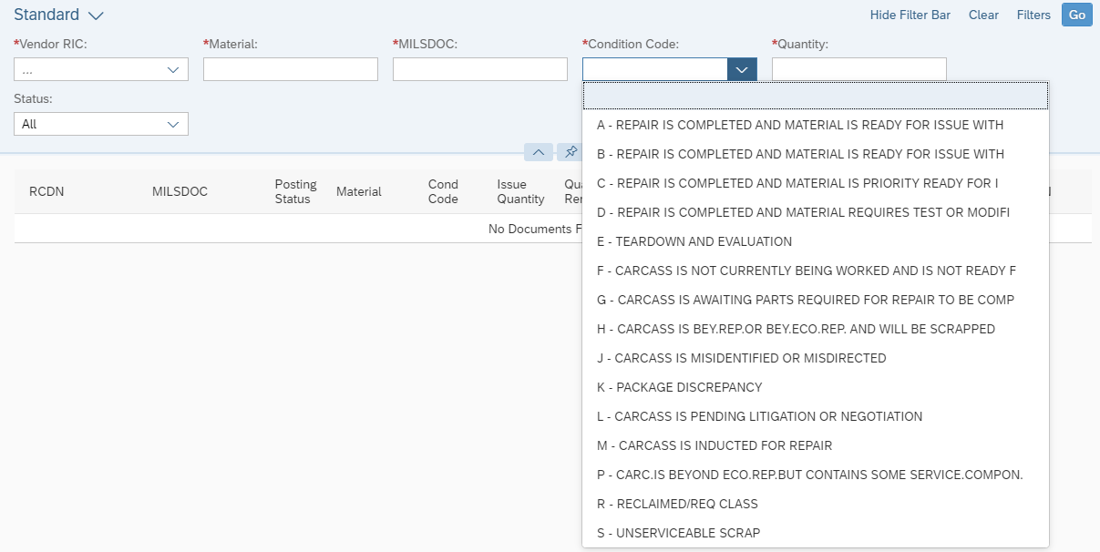
Repair Goods Receipt
Vast majority of receipts will reflect the most common receipt condition codes: F condition, A condition, J condition.
Notes:
Do not receive material in M condition as it will not be matched to a specific contract and will need to be reversed.
You will notice there are a number of condition codes to choose from when receiving material. Assets are typically received in A, F, J. If you feel you need to use one of the other condition codes please work with your CAV-RP analyst and the NAVSUP item manager (Planner) to ensure all parties are aligned on the situation regarding those assets. Do not receive assets in as M or G condition as these require a contract/CLIN to accompany the transaction.
Condition Code:
A - Repair is completed and material is ready for issue without qualification
B - Repair is completed and material is ready for issue with qualification
C - Repair is completed and material is priority ready for issue based on shelf-life
D - Repair is completed and material requires test or modification
E - Teardown and Evaluation
F - Carcass is not currently being worked and is not ready for issue
H - Carcass is beyond physical repair or beyond economic repair and will be scrapped
J - Carcass is misidentified or misdirected
K - Package Discrepancy- Suspended Returns awaiting condition code classification
L - Carcass is pending litigation or negotiation
P - Carcass is beyond economic repair but contains some serviceable components/assemblies to be reclaimed
R - Reclaimed/Req Class
S- Unserviceable Scrap- No stock will be recorded as on hand in Supply Condition Code S as Navy Activities will not use this code
Request submitted to add Q condition- Potential and confirmed product quality deficiency related materiel which is prohibited for use within DoD and prohibited for reutilization screening. Presentation will be updated once this condition code is added.

Slide 14
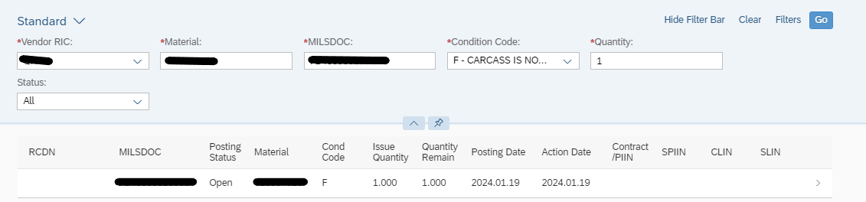
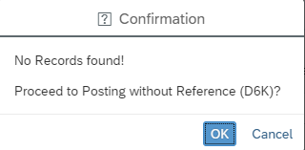
Repair Goods Receipt
If any of the information doesn’t EXACTLY match the open SIT record you will receive a Confirmation pop up message.
READY. RESOURCEFUL. RESPONSIVE.
Notes:
After you click go information you entered will match against the open SIT in NAVY ERP. If the information matches exactly you will see the record pull up with the current posting status. The posting status Open indicates no receipts have been posted against that record, Partial indicates some assets have been posted, but some are still needed, and Closed indicates all receipts have been posted for this SIT record. If the record is closed or any of the entered information doesn’t match exactly you will get a Confirmation message detailing the variance. The receipt can still be posted by clicking “OK.”
You can proceed with the receipt by clicking the document number.

Slide 15
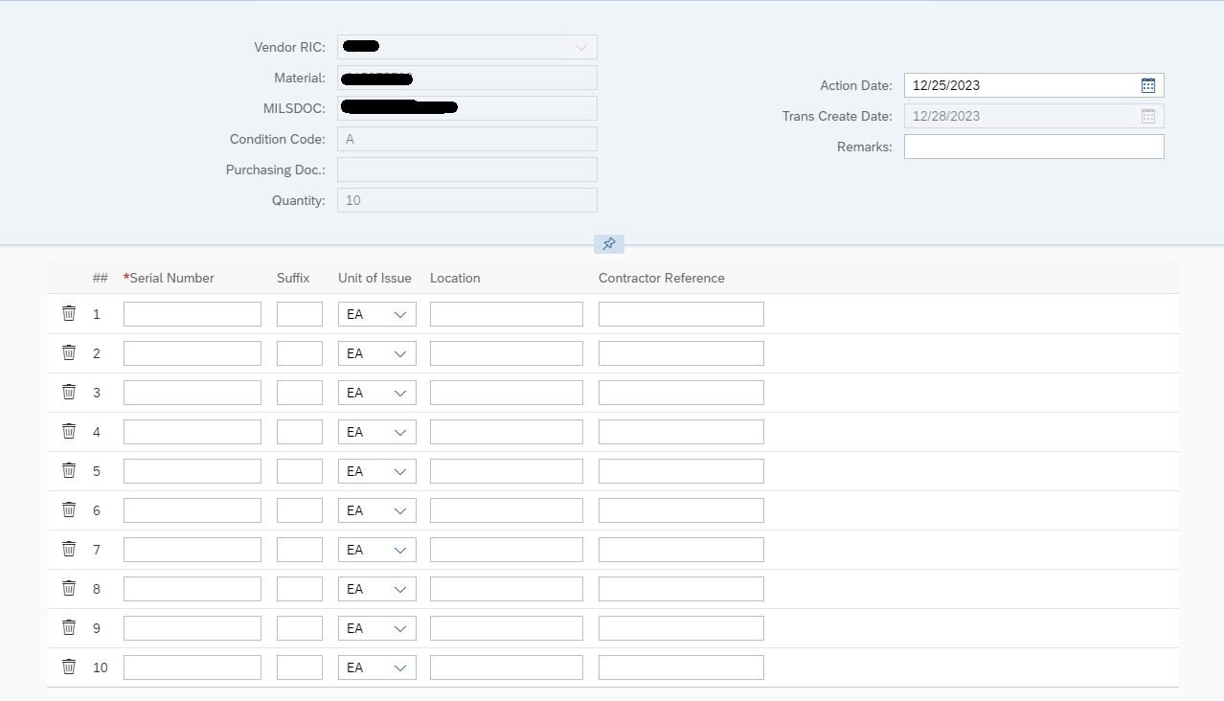


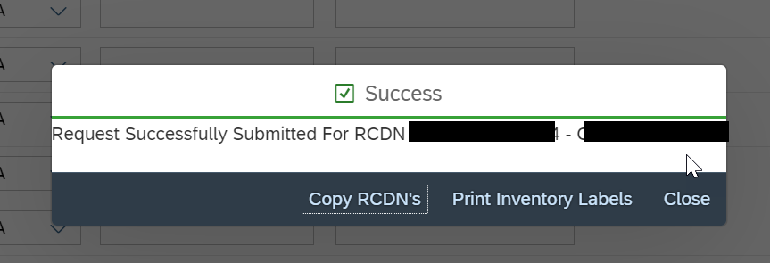
Repair Goods Receipt
Required:
  Action Date - defaults to the current date. Please utilize the date the asset was physically delivered to your facility.
  Serial Number (SN) –
    Input SN located on the physical asset
    If you cannot locate the SN on the asset enter Unknown or UNK
    If the asset is not serialized please enter Not Serialized or NS
Optional:
  Location- Where the asset is being stored (i.e. building #, shelf #)
  Reference Number - Often a number used for internal tracking
    Ex: Work Order #, RMA Number
  Attach Document at the bottom of the screen next to the Post button
READY. RESOURCEFUL. RESPONSIVE.
Notes:
Update Action Date to the date you physically received the material in order to ensure accurate repair turn-around time. Enter the serial number located on the physical asset. If you cannot locate the SN on the asset enter Unknown or UNK. If the asset is not serialized please enter Not Serialized or NS.
Optionally, you can enter the Location if the assets if you want to indicate where the assets will be stored, and Contractor Reference if you assign the assets their own reference number in your internal system.
You can attach the signed DD1348 to the receipt using the Attach Document icon at the bottom of the screen.
After you’ve entered that information click Post. You will receive a Success pop-up. You can choose to copy the RCDNs or print inventory labels from this pop-up.

Slide 16
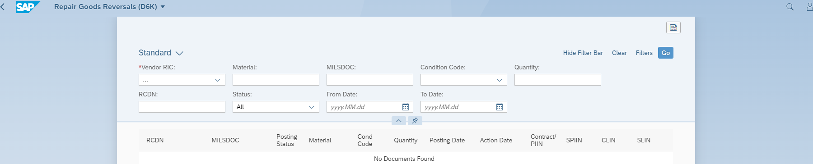
RP Receipt Reversal
Receipts that are aged greater than 30 days will need to be approved by your CAV-RP analyst. CAV-RP automatically sends a notification in RP, but if you want to expedite the process you can reach out to your analyst with the explanation of why the reversal is occurring.
If you reverse a receipt greater than 30 days the asset will still show on hand until your CAV-RP analyst approves the reversal.
Notes:
This is the only reversal screen in the presentation. All reversal transactions follow the same process of the initial posting it just posts a reversal.

Slide 17
J Condition Material
Material not manufactured or repaired by the contractor
File a Supply Discrepancy report (SDR) in PDREP within 5 business days from receipt of the asset (Per CAV SOW FY25)
Receive the NIIN Physically received. If asset NIIN cannot be identified use MDJ111111
Immediately ship asset to the nearest ATAC Hub
  N68620 –ATAC HUB, Norfolk VA
  N46433 - ATAC HUB, San Diego, CA
Use the same document number (source document number) from the incoming DD1348 when shipping J condition
Include a copy of the SDR (SF-364) with the shipment
Notes:
PER CAV SOW FY25
Whenever a NIIN, condition code, and/or quantity discrepancy exists, the Contractor will complete and submit an SDR to the originator of the shipment within five (5) business days after the discrepant shipment is received, via PDREP.

Slide 18
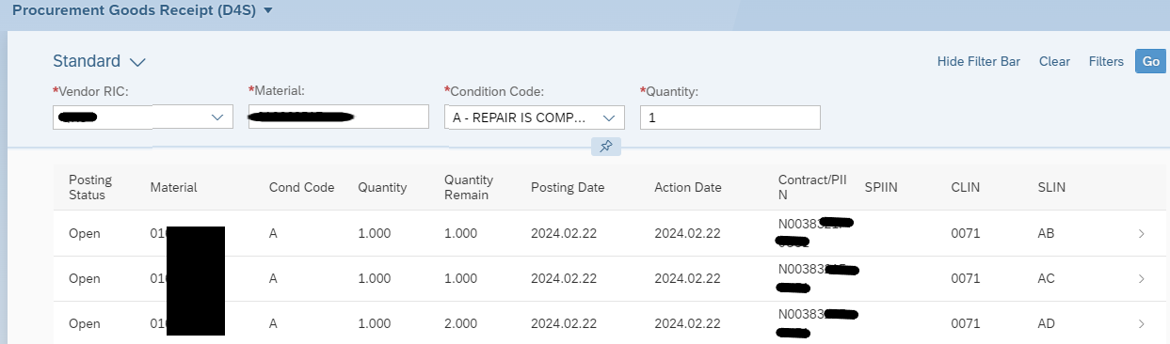
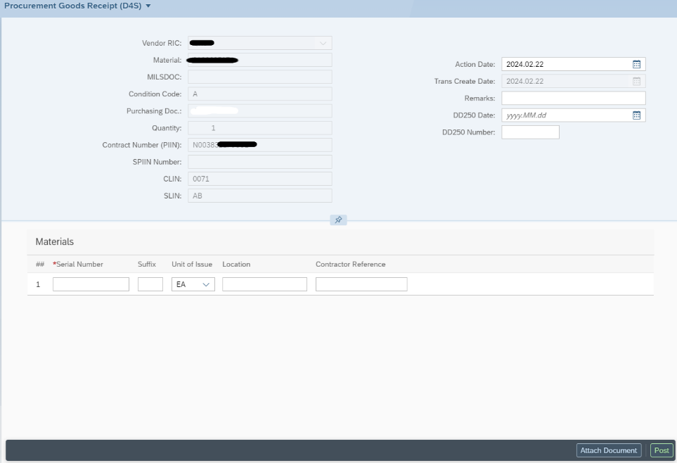
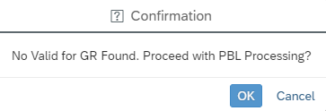
RP Procurement Receipt
Notes:
Enter the search criteria marked with the red asterisk and hit Go
It will match against open procurement contracts. You would click on the CLIN/SLIN line that you want to receive against.
If your site is a PBL and has no open orders for procurement you will get the Confirmation pop-up to manually enter the receipt.
If you’re not a PBL and your contract information does not populate please reach out to your CAV-RP analyst for assistance.

Slide 19
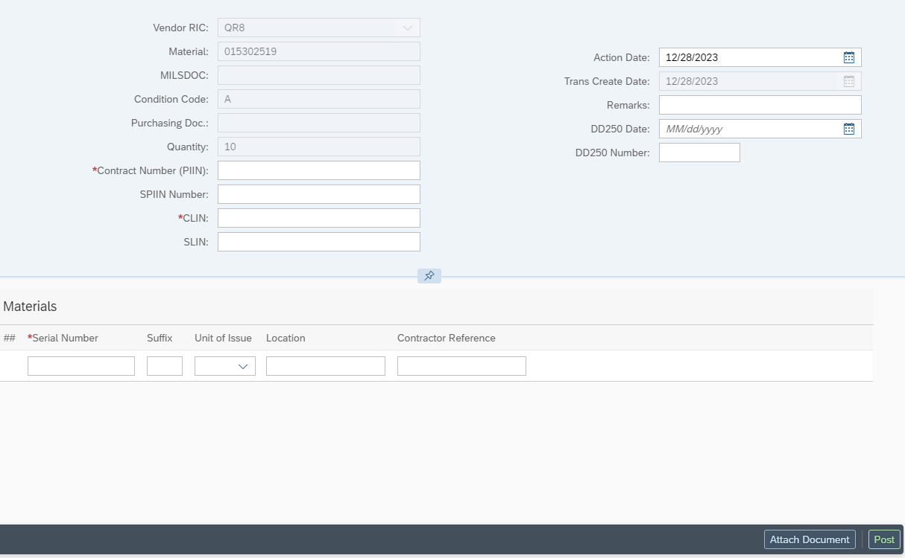
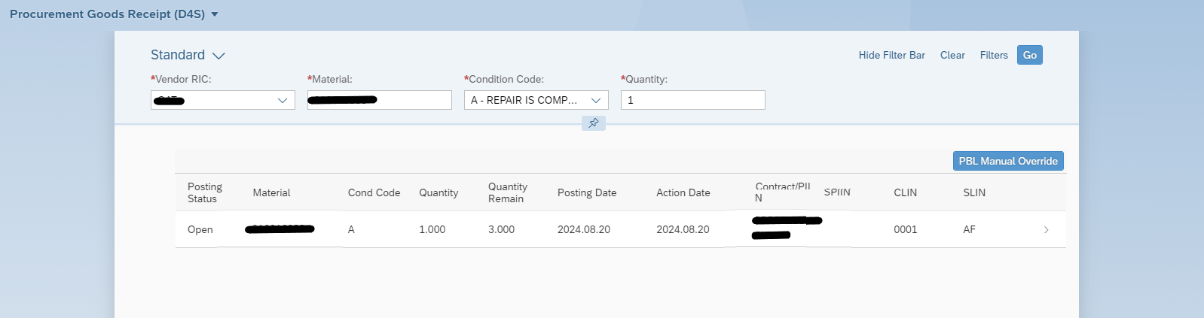
RP PBL Procurement Receipt
Notes:
In the top section, enter in the contract Number, CLIN, SLIN. Though not a mandatory field, the DD250 Number and DD250 Date are very important for the NAVSUP team to match the payment to the DD250 receipt.
In the bottom section you will enter the Serial Number, location, and reference (if applicable). If the asset is not serialized you would enter “Not Serialized” in that field.
If your site is a PBL and has open order for procurement other than the PBL contract, but you need to receive the specific assets against the PBL contract you see an icon appear that states PBL Manual Override which will allow you to proceed with the manual procurement entry.
You can again attach documents at the bottom before clicking Post to process the transaction.

Slide 20
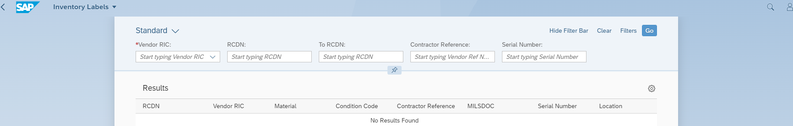
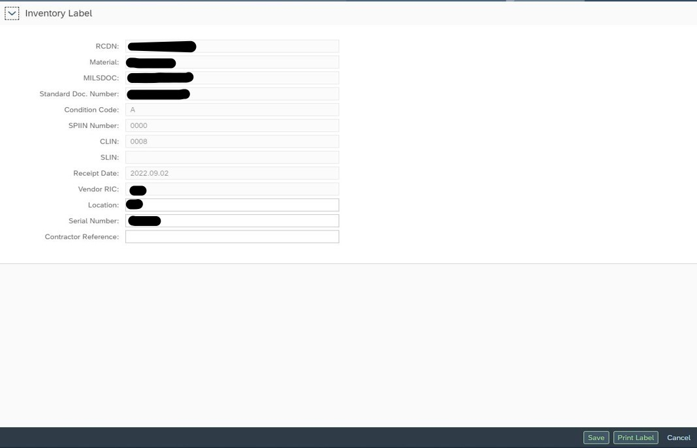
RP Inventory Labels
Inventory Label has taken the place of the MMD from CAV.
This is where you can update the Location, Serial Number, and Contractor reference number for any asset that is not shipped.
Notes:
Inventory Label has taken the place of the MMD from CAV.
Use inventory labels to update the Location, Serial Number, and Contractor reference number for any unshipped/non scrap items.
Enter the search criteria marked with the red asterisk and hit Go.
Click the record you would like to print or update.
We recommend updating serial numbers in inventory labels as opposed to updating them during induction or completion. If you update the serial number during induction or completion and later reverse those transactions the serial number change will be reversed as well.
Currently you can only print one label at a time. We have submitted a heat ticket requesting a change to allow multiple labels to be printed at the same time. We will notify you once that goes into effect.

Slide 21
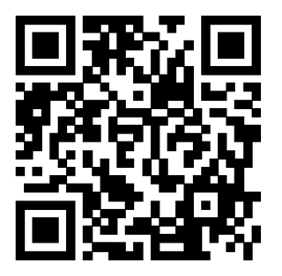
RP Receipt Questions
?

Slide 22
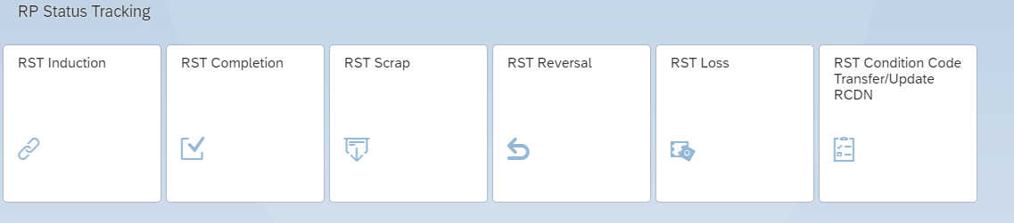
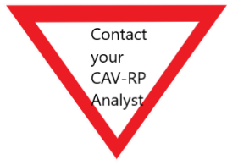
RP Status Tracking
  RP Status Tracking- RST induction, RST Completion, RST Scrap, RST Reversal, RST Loss, RST Condition Code Transfer/Update RCDN
Notes:
RP Status Tracking tiles are used to induct assets into repair, complete assets after repair, scrap assets, post a loss, and transfer assets to a different condition code.

Slide 23
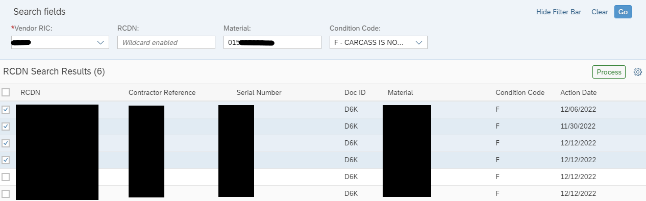
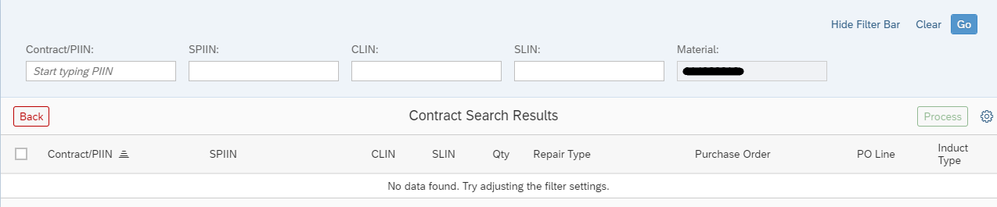
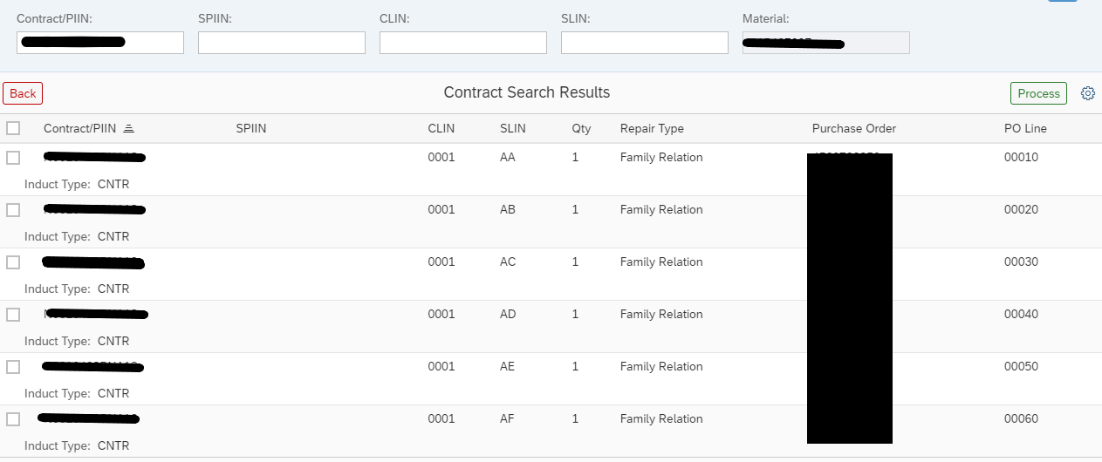
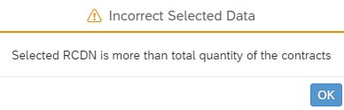
RST induction
Notes:
RST Induction is used to move an asset into repair on a contract. The condition code for these assets will change from F condition into M condition.
Enter your RIC
If inducting a single asset enter an RCDN or partial RCDN (wildcard)
If searching for a wildcard serial number you’ll need to enter the material(NIIN) and condition code.
If inducting multiple assets you can enter the NIIN and condition code and hit Go
Select the asset(s) you want to induct and hit Process
This will bring you to the next page where it states “No Data Found.” You need to enter the contract/PIIN information, and SPIIN/CLIN/SLIN if you want, and hit Go
This should pull up the contract and CLIN and SLINs that are open for that NIIN. Note the quantity column shows the remaining open quantity for that SLIN.
You can select multiple CLINs to induct against as long as the number of assets selected doesn’t exceed the total contracted quantity.
If you exceed this quantity, you will get an “incorrect selected data” pop up.

Slide 24
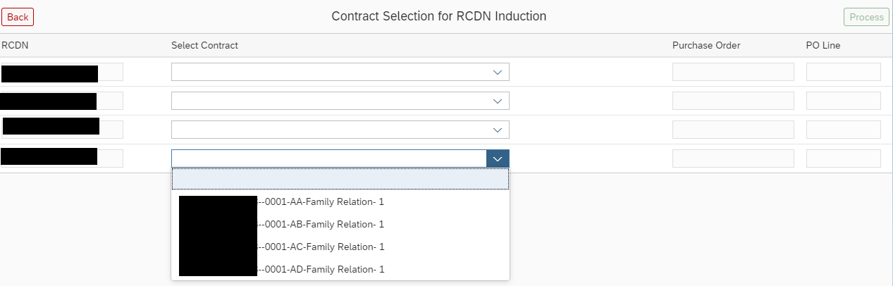
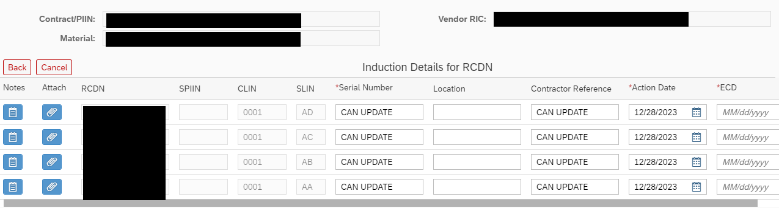

RST induction
Notes:
Assign each RCDN to the proper SLIN if you chose multiple, then click Process.
You can enter notes or attachments to each inducted asset here.
As you scroll to the right, you can update the serial number, location, contractor reference number, Action Date, and the estimated completion date.
The Action Date should be updated to reflect the date when the asset physically went into work. Remember, if you update a serial number at this stage and later need to reverse the induction it will revert to the previous serial number.
Click the Validate button down bottom, then click Post.
If the Action date is prior to the date the asset was received in CAV-RP you’ll get an error when you click Validate. The action date must be equal to or greater than the receipt action date.

Slide 25
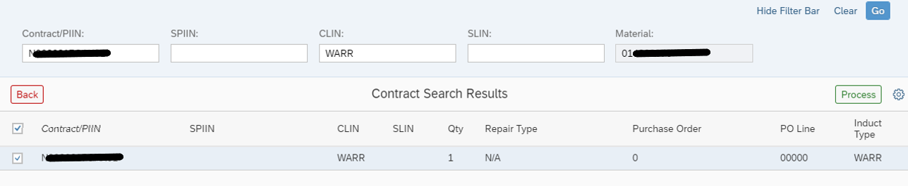
Warranty/PQDR Induction
Notes:
When inducting an asset for repair for Warranty or PQDR enter the contract number the asset was last repaired on, and WARR or PQDR as the CLIN and click Go.
Check the checkbox next to the contract and click process.
This will bring you to the induction screen shown previously.
You can enter notes or attachments to each inducted asset here.
As you scroll to the right, you can update the serial number, location, contractor reference number, Action Date, and the estimated completion date.
Click the Validate button down bottom, then click Post.

Slide 26
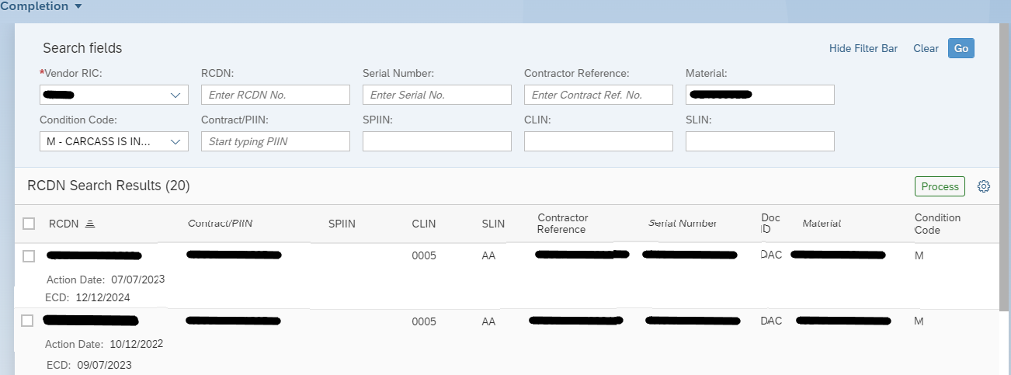
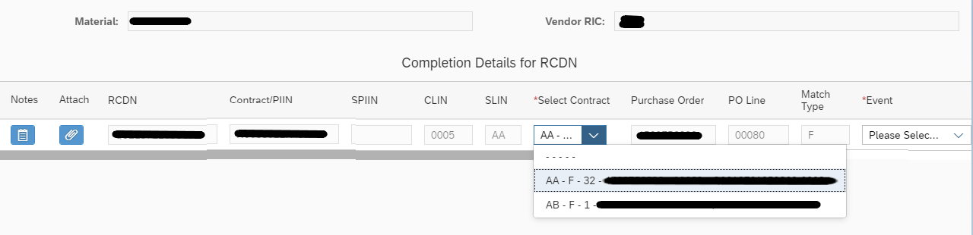
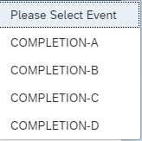
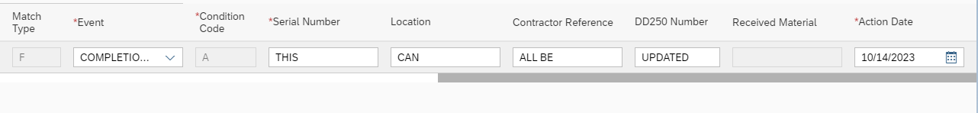
RST Completion
Notes:
Contract/PIIN is the contract or order number- 13 characters usually starting with N00383 or N00104
CLIN is a 4 digit number, for example 0001, 0002, 0003, etc.
SLIN- two letters, for example AA, AB, AC, etc.
To complete an asset that has been repaired enter the search criteria at the top of the page. If you want to induct multiple assets at the same time you would enter the material (NIIN) and condition code, then click Go.
You can select multiple assets to complete at the same time, however they need to be the same NIIN, contract, and CLIN. After selecting the assets to complete click Process.
If you are completing one asset you can update the SLIN at this stage, however If completing multiple assets you wont be able to change the SLIN.
If you are trying to complete on a different SLIN and it isn’t showing in the “select contract” dropdown, check to make sure the CLIN/SLIN isn’t fully inducted. If there was a mod to add or increase the number of repairs to a SLIN ensure it has been updated in NAVY ERP.
The Event drop down indicates which RFI condition code the asset will be. This will most often be Completion-A. If you feel another completion condition code should be used you should consult with the NAVSUP item manager/Planner and CAV-RP analyst/supervisor to ensure the asset(s) are being reported accurately.
You can update the serial number, location, reference number, DD250 No., Action Date, and upgrade NIIN. If upgrading to a new NIIN, that new NIIN should show in the Received Material box. If it does not show the upgrade NIIN, ensure the contract is set up as shown on the next slide. If the contract needs to be updated please reach out to your contracting officer and CAV-RP analyst for assistance.
Click Validate then Post.

Slide 27
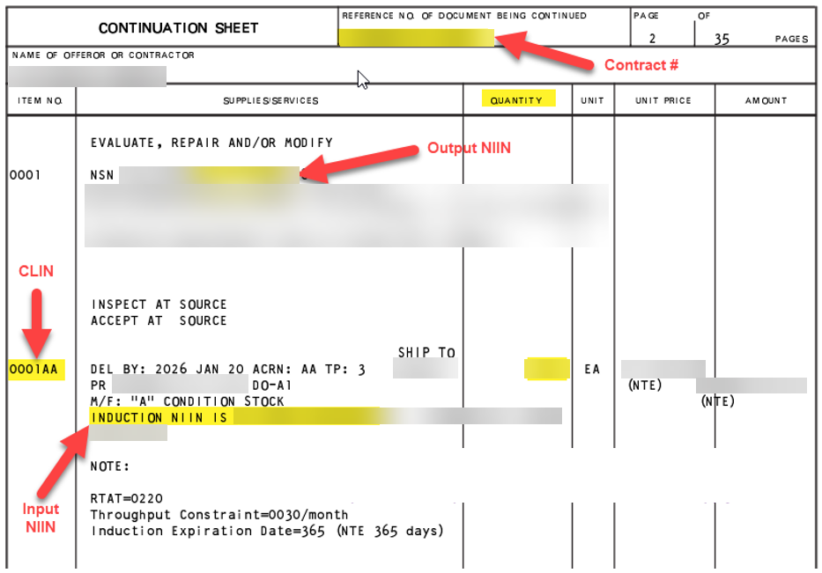
Upgrade NIIN
If your contract isn’t set up as shown above and you need to do an upgrade reach out to your NAVSUP Contracting specialist for assistance.
Notes:
If your contract isn’t set up as shown above and you need to do an upgrade reach out to your NAVSUP Contracting specialist for assistance.

Slide 28
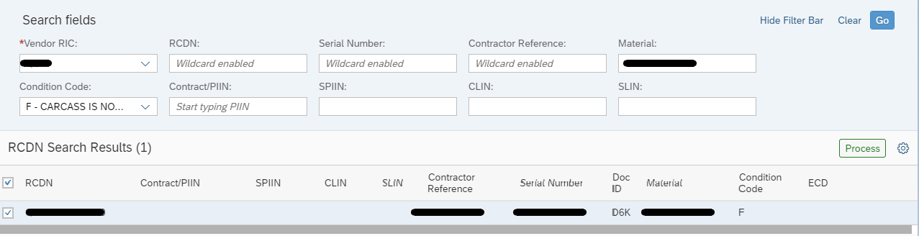
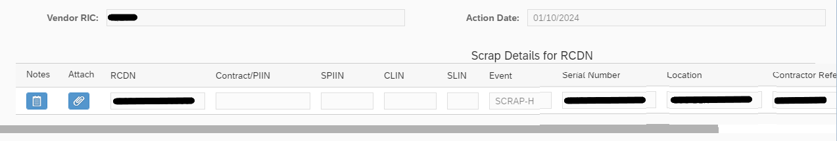
RST Scrap
Enter search criteria and hit Go
Select your assets and click Process
You wont be able to change any of the information on the scrapped assets here, but you can add attachments or notes if you’d like.
Click Validate then Post in the bottom Right
Notes:
RST Scrap moves the assets into H condition. This can be done from both F and M condition. You wont be able to update the serial number during the scrap transaction so make sure you do that using the Inventory Labels tile prior to processing the scrap.
Enter search criteria for the asset you want to scrap and click Go.
Use the checkbox next to the RCDN line to select your assets and click Process.
You wont be able to change any of the information on the scrapped assets here, but you can add attachments or notes to help assist in retrieving KSDs in the future.
Click Validate then Post in the bottom right corner of the screen.
There is currently a known issue reversing an asset from a CLIN to place on BER CLIN. If you’re unable to reverse and put on a new CLIN the asset can still be shipped as scrap and the NAVSUP team will match against the BER line in ERP.
We recommend moving assets to H condition from F condition to avoid the known issue above.

Slide 29
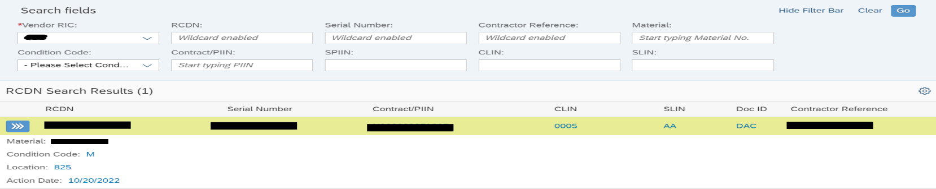
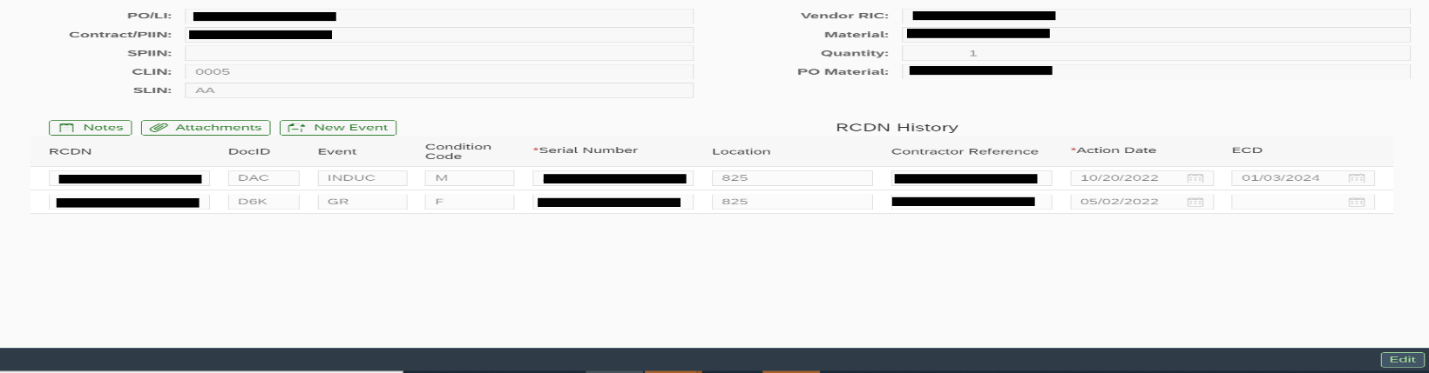
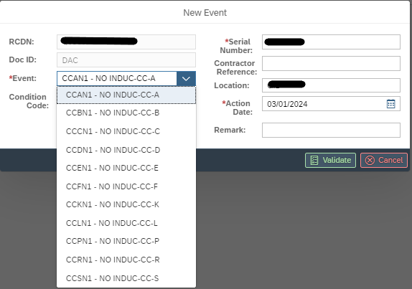
RP Condition Code Transfer/Update RCDN
Notes:
Enter in your search criteria and hit Go
Click the blue icon to the left to select the asset you’d like to edit. That will bring you to the next page.
Click the Edit button at the bottom of the screen and that will allow you to edit the Estimated Completion Date, serial number, action date, and reference number.
Click the New Event icon to change the condition code. Note: using this function to update the condition code to an RFI condition, such as A condition, may cause problems when trying to get paid for a repair as NAVSUP will not see the repair completion linked to a contract.
Depending on the current condition code of the asset you will be limited to what condition you can transfer to. Below is a list of condition you can transfer to based on the current condition:
From F condition you can transfer to A, B, C, D, E ,J, K, L, P, R, and S condition.
From M condition you can transfer to Awaiting Parts G condition, or unserviceable P condition
From A condition you can transfer to J, L, and P condition.

Slide 30
RP Status Tracking Questions
?

Slide 31
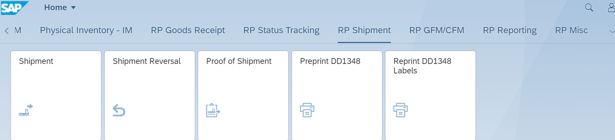
RP Shipment
  Shipment-shipping assets and scrap material
  Shipment Reversal
  Proof of Shipment- Posting tracking info for Non-ATAC shipment
  Preprint DD1348- Print before shipping
  Reprint DD1348- Print after shipping
Notes:
In this section we will walk through the different types of shipments, proof of shipment, Preprinting DD1348s, reprinting DD1348s, and Repair requisition reports.

Slide 32
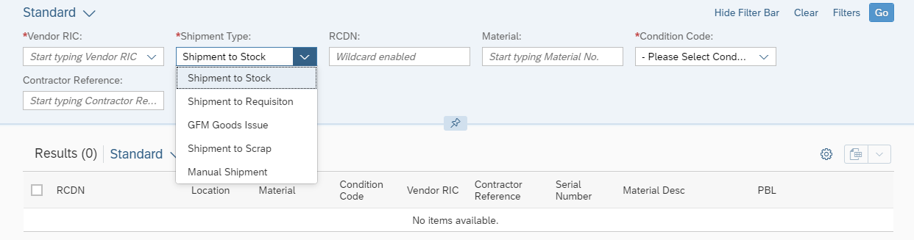
Shipment
Shipment to Stock- Shipping to a DLA Depot or J condition to ATAC Hub
Shipment to Requisition- Filling a requisition directly to fleet activities
GFM Goods Issue- consuming a repaired asset into the repair of another asset.
Shipment to Scrap- Shipping a scrapped asset
Manual Shipment- Classified and/or manual entry of requisitions
Notes:
The shipment types are listed below:
Shipment to Stock- Shipping to a DLA Depot or J condition to ATAC Hub
Shipment to Requisition- Filling a requisition directly to the fleet
GFM Goods Issue- consuming a repaired asset into the repair of another asset.
Shipment to Scrap- Shipping a scrapped asset
Manual Shipment- Classified and or manual entry of requisitions
Once you have entered that information click Go.

Slide 33
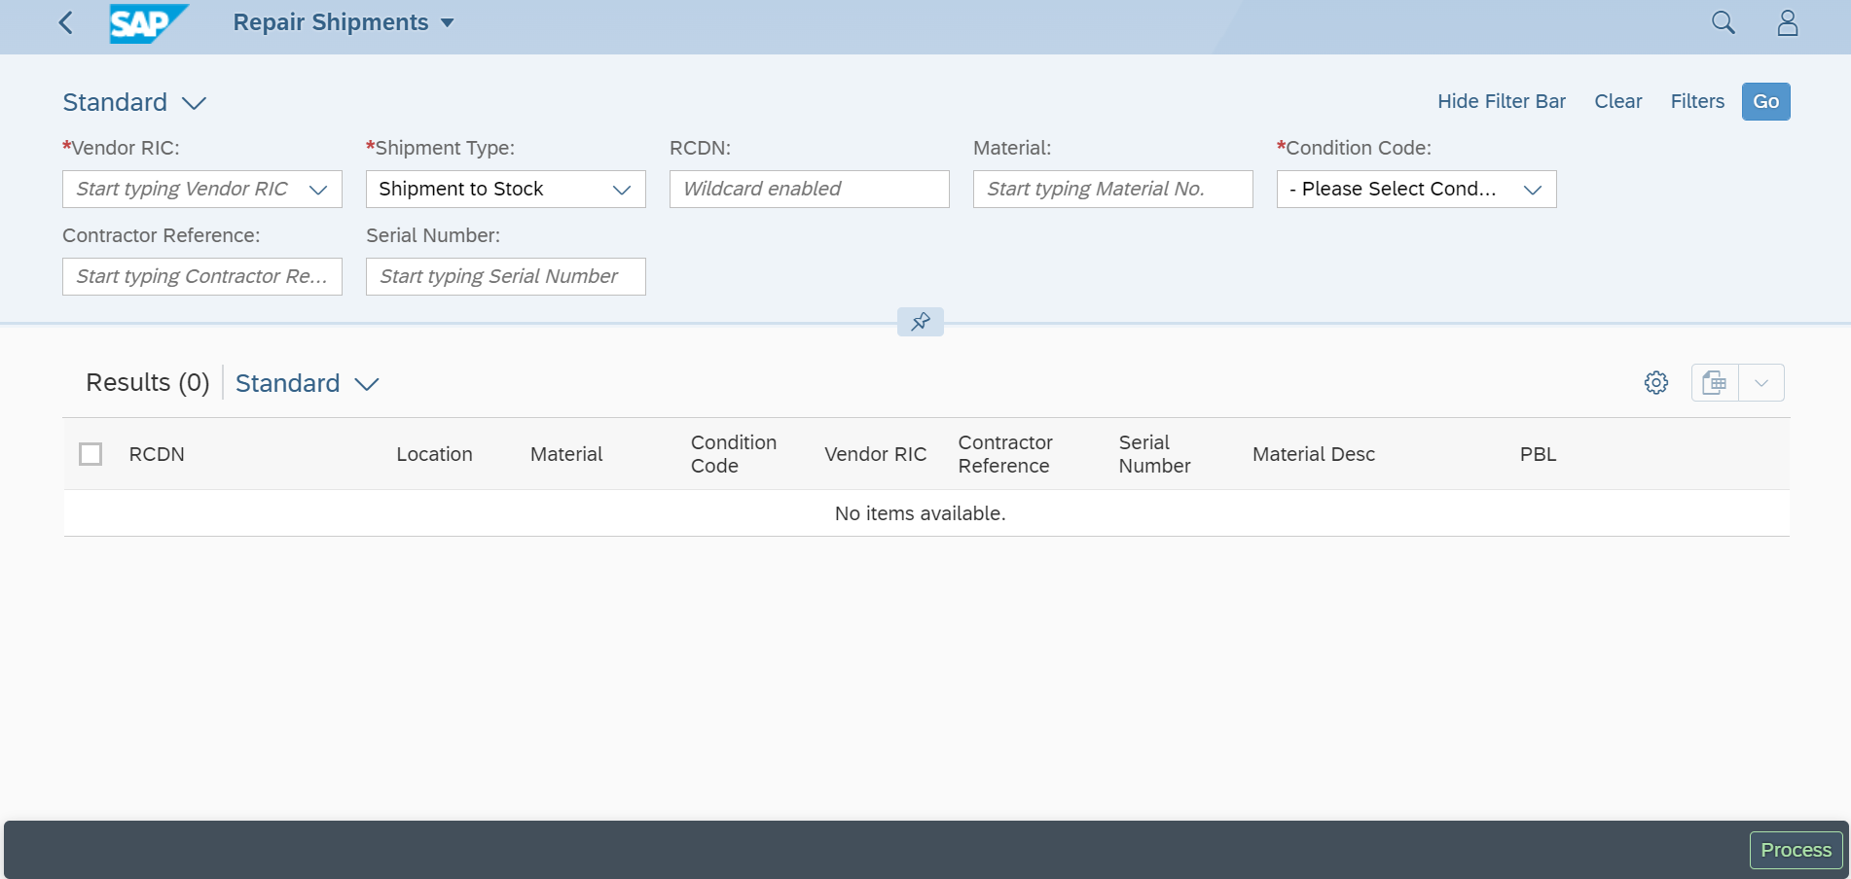
Shipment
Select asset by searching RCDN, Material(NIIN), Condition code, Reference number, and/or Serial number.
If searching by serial number a NIIN is required.
RCDN is “wildcard enabled” meaning you can use a portion of the RCDN to search.
Notes:
To ship an asset enter your search criteria up top along with the Shipment type.
Enter an RCDN if you're shipping a single unit. Enter NIIN/CC if shipping multiple units.
If searching by RCDN you can use a portion of the RCDN to search due to this field being “wildcard” enabled for this function.

Slide 34
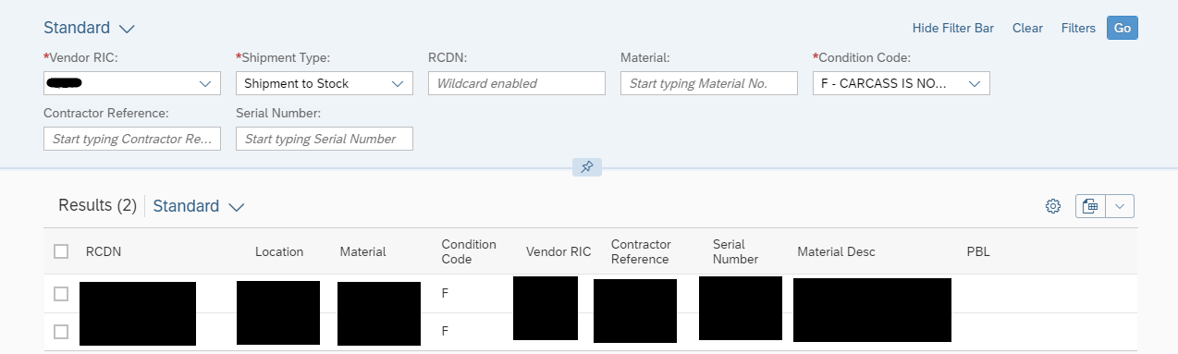
Shipment
Ship Asset Selection
Select the asset(s) you would like to ship and click “Process” in the bottom right
NOTE: If shipping to stock you can bulk ship up to 10 assets as long as they’re the Same NIIN, Condition Code, going to the same destination, and in the same Pallet/Box.
Notes:
If shipping to stock you can bulk ship up to 10 assets as long as they’re the Same NIIN, Condition Code, going to the same destination, and in the same Pallet/Box.
Check the checkbox next to the RCDN the asset(s) you would like to ship and click “Process” in the bottom right.

Slide 35
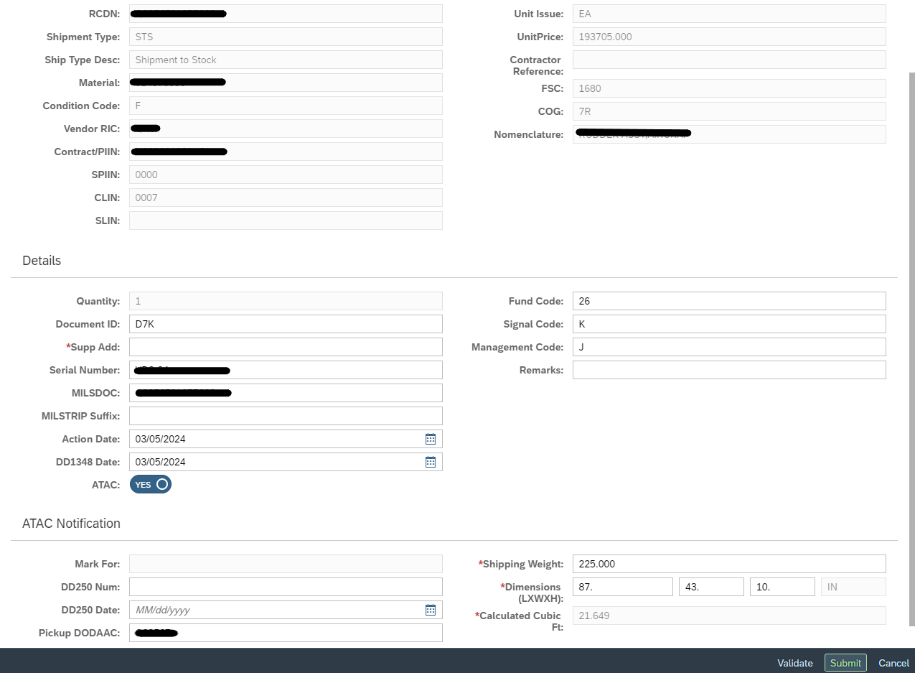
Shipment to Stock
  Supp. Add. is your “Ship To” DoDAAC
  The MILSDOC field is your shipping document number.
  If shipping J condition assets remember to change the MILSDOC field to the document number you received the asset on
  ATAC will default to YES; if an ATAC pick up is NOT needed, then change to NO
  Enter Weight and Dimension
  Change the pickup DoDAAC if needed
ATAC Email: ATACcustomerservice@us.navy.mil
Notes:
Enter the DoDAAC you are shipping to as the Supp Add.
You can update the serial number here, but remember that if you reverse this shipment later the serial number change will be reversed as well.
MILSDOC number defaults to the assets RCDN. If shipping J condition material the assets should be shipped using the document number it was received on, not the default RCDN. J condition material should be shipped to the nearest ATAC hub which are listed below:
East Coast ATAC ATAC Norfolk – PDH/N68620
West Coast ATAC ATAC San Diego – PDJ/N46433
The Fund Code, Signal code, and Management code are all default values. The priority of Shipment to stock is 06.
The ATAC switch is on by default. If you are not shipping via ATAC you would need to click this switch off.
Enter in the weight and dimensions as well as update the Pickup DoDAAC if the asset is being picked up from somewhere else, such as a packaging house, then click submit.
A pop up will appear which allows you to print your DD1348.
Reminder- Shipment to stock should not be used to ship assets to the fleet, and also never ship an asset to the fleet using an RCDN as the MILSDOC number
If you are shipping using ATAC you should receive your shipping labels within 24-48 hours. If you have not received labels at that time you can reach out to ataccustomerservice@us.navy.mil and copy your CAV-RP analyst.

Slide 36
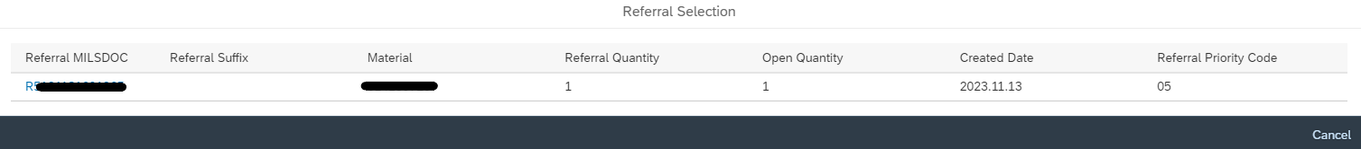
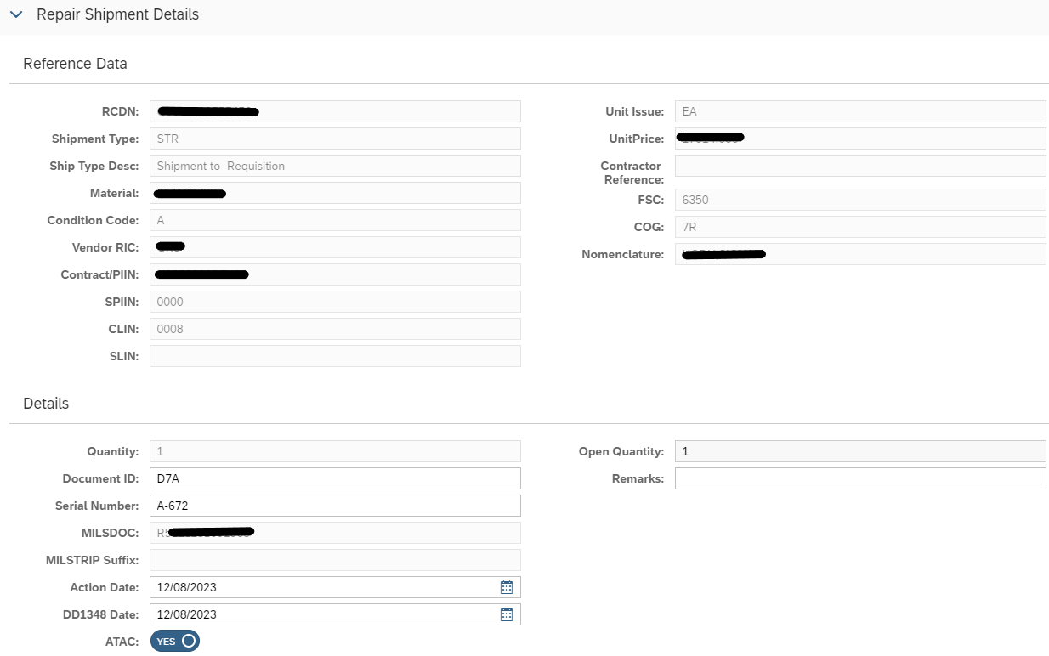
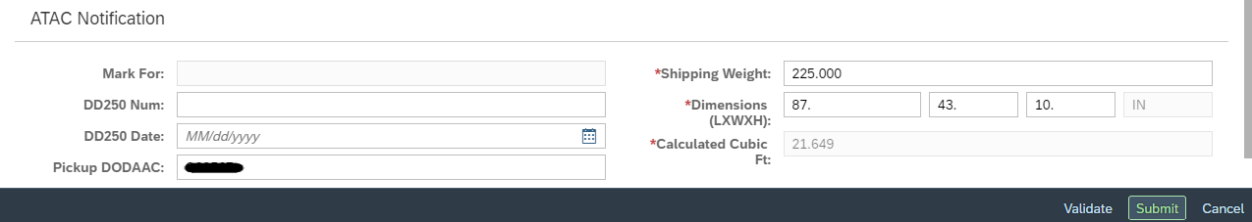
Shipment to Requisition
Notes:
After selecting Shipment to Requisition and the asset to ship, a list of open requisitions for that material will populate.
Select the requisition you’re filling and the req information will be prefilled on the next page.
You would then enter the weights and dimensions if shipping ATAC, then click Submit.
A pop up will appear which allows you to print your DD1348.

Slide 37

Repair Requisition Report
_________________________________________________________________________
Notes:
If your site is Direct Ship enabled, meaning you receive requisitions to ship material directly to fleet activities, you are required to check the repair requisition report within 24 hours of
reporting the completion transaction.
On the RP-Reporting tab, choose Repair Requisition Report.
Enter your RIC, NIIN and Condition code, or if you already have the requisition document number you can enter that in MILSDOC, and hit GO. *Note that the posting date defaults to 44 days prior to today, so if you’re looking for a requisition prior to that you would have to change the dates.
Overall Status Defaults to All, but you can also search by a particular status, I.E. Active (unfilled); Partially Filled; Filled; Deleted; Denied, Overdue; or Cancelled.
This will bring up the list of requisitions for your selected search criteria. You can either export the list to excel, or click on the requisition you want to ship.

Slide 38

Repair Requisition Report
Notes:
Clicking on a requisition line will bring up the information for that Req. You can choose an Action down bottom to Deny, Cancel, Update Estimated Ship Date (ESD), or Delete.
Please do not deny a requisition unless you have been asked to do so by a NAVSUP Item Manager/Planner. If you deny a requisition it will block all A condition units currently on hand and prevent further requisitions from being processed. If you do deny a requisition by request by the NAVSUP Planner please reach out to your CAV-RP analyst so they can work on unblocking the stock.
You can also choose Shipments to jump to the Shipment function with the information for that Req pre-populated.

Slide 39


Repair Requisition Report
*Note: If you are a PBL site, you may receive the Warning message above.
If you choose “No” it will pull exact matches for that NIIN
if you choose “Yes” it pulls your full inventory
Notes:
If you click on shipments from the previous screen you will be brought to the ship screen with the information prefilled.
*Note: If you are a PBL site, you may receive the Warning message above.
If you choose “No” it will pull exact matches for that NIIN
if you choose “Yes” it pulls your full inventory

Slide 40
Repair Requisition Report
Notes:
This will bring you to the same shipment screen as before where all the information will auto-populate. You would only need to input the weights and dimensions if shipping via ATAC.

Slide 41

Shipment to Scrap
  Supp. Add. is your “Ship To” DoDAAC
  The MILSDOC field is your shipping document number.
  If shipping J condition assets remember to change the MILSDOC field to the document number you received the asset on
  ATAC will default to YES; if an ATAC pick up is NOT needed, then change to NO
  Change the pickup DoDAAC if needed
Notes:
After selecting Shipment to Scrap and selecting the asset to ship, you will be brought to the next screen.
If you are scrapping the asset on site you would enter your DoDAAC as the Supp Add. If you are shipping the asset out to be scrapped you would enter the DoDAAC where you are shipping the asset.
You must uncheck the ATAC switch due to ATAC not being involved with scrap shipments.
A pop up will appear which allows you to print a DD1348. Print name, Sign, date. Upload it Commercial Repair Upload (see next slide)
The records must be preserved for 10 years per the CAV SOW FY25. You can use the Commercial repair upload feature to store these records.

Slide 42

Manual Shipment
Notes:
After selecting Manual shipment and selecting the asset to ship, you will be brought to the next screen.
For manual shipments you will need the Supp Add(ship-to DoDAAC), Milsdoc number, Priority, Fund Code, Signal Code, and advice code. This information can be found in ERP or obtained by the NAVSUP item manager.
You would then enter the weights and dimensions if shipping ATAC, then click Submit.
A pop up will appear which allows you to print your DD1348.

Slide 43

GFM Shipment
GFM is used to consume one A condition unit into the repair of another unit
Enter your DoDAAC as the Supp Add
The MILSDOC will default to the document number the asset was received on
Update the action date to the date the asset was consumed
Management code- was there a repairable F condition asset that this asset is replacing? If yes, choose 5G and receive that F condition asset into CAV-RP. If no choose 5A and click Submit.
Example: You repair both Pen Caps (sub assembly) and whole pens (main assembly). You are consuming a CAV-RP reported A condition Pen Cap into the repair of a whole Pen. Did whole pen come in with an F condition Cap (use 5G) or was it missing when it came in for repair (use 5A)?
Notes:
GFM is used to consume one A condition unit into the repair of another unit.
Search for asset that is GFM and click Go.
Check the checkbox next to the RCDN of the asset and click Process.
This will bring you to the next screen where you’ll enter your DoDAAC as the Supp Add.
The MILSDOC will default to the document number the asset was received on.
Update the action date to the date the asset was consumed.
Select the proper Management code- was there a repairable F condition subassembly coming off the asset being repaired? If yes, choose 5G and receive that F condition asset into CAV-RP. If no choose 5A and click Submit.
Management Code Example: You repair both Pen Caps (sub assembly) and whole pens (main assembly). You are consuming a CAV-RP reported A condition Pen Cap into the repair of a whole Pen. Did whole pen come in with an F condition Cap (use 5G) or was it missing when it came in for repair (use 5A)?

Slide 44


Proof of Shipment
Enter asset selection information and hit GO, then select asset.
You can then review the information on top to ensure you selected the correct shipment.
Enter the shipment Mode- How the asset was shipped i.e. Air (J), Ground (G), etc.
Enter SCAC Code- See list of SCAC Codes.
Enter Tracking Number
List of SCAC Codes
Notes:
Enter RIC, condition code, and document number or rcdn shipped and hit GO, then select shipment.
You can then review the information on top to ensure you selected the correct shipment.
Enter the shipment Mode- How the asset was shipped i.e. Air (J), Ground (G), etc.
Enter SCAC Code- See list of SCAC Codes.
Enter Tracking Number
If processing a local shipment the tracking number would be the name and date of the person who signed for the delivery of the asset, for example “JohnDoe09132023”
If your contract specifies you are to use ATAC when shipping and, without NAVSUP approval, you ship assets without ATAC you assume responsibility if the shipment is lost or damaged. If you do not receive labels from ATAC reach out to your CAV-RP analyst for assistance.

Slide 45

Preprint and Reprint DD1348
Preprinting DD1348 before shipping is the same process as shipping the asset
Reprinting a DD1348 after a shipment is processed is as simple as entering the search criteria for the asset and printing the DD1348 again.
Notes:
Preprinting DD1348s follow the same selection process as conducting the actual shipment.
You are able to preprint for all assets except Condition Codes M or G condition.
Preprinting does not transmit or save anything in the system so you will need to ensure the information is entered the same way during shipment.
You can update the condition code on the pre-print DD1348, but this will not update the condition code in the system itself
The ATAC Toggle includes the weight and Dims on the DD1348. Turning it off defaults the values to 0.
DD1348 preprint requisition issue fixed?
To reprint a DD1348 you would enter the search criteria and click Go.
Click on the asset that shows in the results and the DD1348 will automatically load on a new page for you to print.

Slide 46



Shipment Warnings
Shipment Warnings and Information
J condition shipments will automatically RE-ID to F condition before processing.
If you choose “Shipment to Stock” for PBL assets, classified assets, and/or assets that have active requisitions will receive a warning message.
**Reach out to your CAV-RP Analyst if you have questions about a warning message you receive.
Notes:
There are a few different Pop-up warnings you may receive when shipping assets. These are a few of the more common pop-ups.
J condition shipments will automatically RE-ID to F condition before processing.
If you choose “Shipment to Stock” for PBL assets, classified assets, and/or assets that have active requisitions will receive a warning message.

Slide 47
Shipment Questions
?

Slide 48
Reporting and Misc.
  GFM Creation
  RP Reporting
  Misc. Functions

Slide 49

RP GFM
Notes:
During the repair of an asset the site needs to request A condition Government Furnished Material (GFM) from NAVSUP to complete the repair they would use the GFM creation tile to requisition the asset be sent to them.
CFM customer furnished material currently not utilized. Your NAVSUP CAV-RP analyst will determine if this function is to be used and provide guidance.

Slide 50

GFM Creation
Notes:
Site would input their RIC and the material, being requested, along with the Advice code, Fund Code, Project Code and Priority and click Post. A pop up will appear stating if the requisition posted successfully along with a requisition number. If you’re not sure which Advice code, Fund Code, Project Code and Priority to use reach out to the NAVSUP Item manager.
Advice code-
5A- Replacement certification. Requested item is required to replace a mandatory turn-in repairable which has been surveyed as missing or obviously damaged beyond repair.
5G -Exchange certification: (1) Requested item is a mandatory turn-in repairable for which an unserviceable unit will be turned-in on an exchange basis under the same document number as that used in the requisition. (2) Requested item is compressed gas for which an empty cylinder will be turned-in on an exchange basis.
5S- Remain in place certification. Requested item is a mandatory turn-in repairable for which an unserviceable unit will be turned-in on an exchange basis after
receipt of a replacement (serviceable) unit. The turn-in document number will be the same as that used in this requisition.
Fund Code-
HM- NAVSUP WSS PHIL -Repair.
HS-NAVSUP WSS MECH - Repair.
WH-NAVSUP WSS MECH - Procurement.
WF- NAVSUP WSS PHIL -Procurement.
Project Code-
ZN3-Applicable to FRC Replacement Requisitions for FRC Component Removals
ZV3-Applicable to FRC Requisitions for Components Missing on Induction (MOI)
ZL8- FRC Requisitions which do not meet ZN3, ZV3, or ZM3 criteria

Slide 51
RP Reporting
  Repair Requisition Report- view and fill requisitions- See shipment slides
  Repair Material report-Summary- shows the current reported status of assets (once processed)
  Repair Material report- History- shows transaction history of assets
  Commercial Repair Turnaround Time (RTAT)-shows number of days between induction and today or induction and completion.
  Due in Report- SIT report See receipt slides
  Commercial Repair Scorecard- Snapshot of key stats for SIT, past due ECDs, total open Requisitions
  Stock Reconciliation report- Shows summary of variance between CAV-RP stock and NAVY ERP
  Transaction Reconciliation Report- Shows detailed list of items that are causing variance between CAV-RP and NAVY ERP
Notes:
RP Reporting tiles are used to run the following reports:
Repair Requisition Report- view and fill requisitions (see RP Shipments section for walkthrough)
Repair Material report-Summary- shows the current reported status of assets (once processed)
Repair Material report- History- shows transaction history of assets
Commercial Repair Turnaround Time (RTAT)-shows number of days between induction and today or induction and completion.
Due in Report- Shows assets that have been shipped to you and awaiting receipt. (See RP Receipt for walkthrough)
Commercial Repair Scorecard- Snapshot of key stats for SIT, past due ECDs, total open Requisitions
Stock Reconciliation report- Shows summary of variance between CAV-RP stock and NAVY ERP
Transaction Reconciliation Report- Shows detailed list of items that are causing variance between CAV-RP and NAVY ERP

Slide 52

Repair Material Reports
Repair Material Summary- The most recent status of each asset reported.
Repair Material History-
Notes:
Click the gear towards the center of the screen to add and organize additional fields you want in your report.

Slide 53
Repair Material Reports
Summary columns not found in History
Facility
PO Line
Posting Date
Warranty
History columns not found in Summary
Attachments | Recvd Material
Bill of Lading | Reference Code
Creation Date | Reference ID
Creation Time | Remarks
Delivery Date | SCAC
Misidentified/Misdirected Material | Shipment Cube
Pickup DoDAAC | Shipment Mode
Priority Code | Tracking Number
Purpose Code | Transaction Date
Quantity | User ID
Record Type | User Name
CAV Repair Item Action to CAV-RP Material Summary
Notes:
There are a few fields that appear in one report, but not the other. Above is the list of fields that are in Summary, but not in History and also a list of fields that are in History and not in Summary.
Below is the list of fields that are in both reports.
Columns in Common embed glossary
Action Date, Advice Code, CAGE, CLIN, COG, Condition Code, Condition Code From, Contract/PIIN, Contractor DoDAAC, Contractor Reference, DD1348 Date, DD1348 MILS Inbound, DD1348 MILS Outbound, DD250 Date, DD250 Number, Dimension, Display Notes, Display Option, Distribution Code, Doc ID, ECD, ECD Status, Fund Code, Location, Management Code, Material, Material Description, MILSDOC, Order Quantity, Order Unit, PAYBK/BOROW, PBL Indicator, PO Line, Project Code, RCDN, RDD, Repair Event, Repair Status, Reversal Indicator, RIC To, Serial Number, Ship to DoDAAC, Shipment Status, Shipped Date, Signal Code, SLIN, SMIC, SPIIN, Status, Unit of Issue, Unit Price, Vendor RIC,

Slide 54

Commercial Repair Turnaround Time
Notes:
Commercial Repair Turnaround Time shows the number of days an asset has been inducted into work, or how long it took to repair an asset once its complete.
Enter your search criteria at the top and click Go.
You’ll need to select a Repair Status. Repair Status in Process shows when the unit was inducted and, if its past due, how far past due it is. Repair Status Complete shows the completion date and how long the item was in work.
You can add and/or arrange the columns using the Cog wheel toward the center, and export to excel.

Slide 55

Commercial Repair Scorecard
Snapshot of key statistics for:
    Total Open Stock In Transit
    Total misdirect units on hand greater than 5 business days
    Total past due estimated completion dates
    Total over-inducted contract lines
    Total active unfilled requisitions
Notes:
Commercial Repair Scorecard shows a snapshot of a few key statics for a selected plant.
The fields are all automatically selected, but you can rearrange them using the cog wheel toward the center. You can also export this to excel using the export icon next to the cog wheel.
The fields are:
Vendor RIC
Vendor Cage
Total Open Stock In Transit
Total misdirect units on hand greater than 5 business days
Total past due estimated completion dates
Total over-inducted contract lines
Total active unfilled requisitions
Plant

Slide 56


Stock Reconciliation report
Notes:
Stock Reconciliation Report shows variances between CAV-RP (RPACTN Quantity) and NAVY ERP (ECC Quantity) at the material level.
When entering a RIC you may see more than one plant to select. You will choose the C-Plant option for NAVSUP repairable assets.
You can enter a specific NIIN and condition code, or run it open to see all NIINs and condition codes for that site.
If you check the Discrepancies checkbox it will only show NIIN/Condition codes that have a variance between CAV-RP and Navy ERP. If you uncheck that box it will show All NIIN/Condition Codes.
All report fields are shown, and you can again reorganize using the Cog Wheel toward the center of the screen. You can export to excel using the export icon next to the cog wheel.
Uncheck discrepancy for all NIINs
Used for pulling inventory for W2W

Slide 57

Stock Reconciliation report
Per the CAV SOW W2W inventories are to be completed by using the Stock Reconciliation report.
One report should be run with the on hand quantities and another without.
Notes:
The CAV-RP Statement of work mandates CAV-RP reporters conduct an annual Wall to Wall inventory using the Stock reconciliation report.
To run that report, uncheck discrepancies and all other columns except for Plant, material, and RP action quantity.
The exact verbiage in the CAV-RP Statement of work is below.
The Contractor will complete a physical count of all on hand assets for a particular NIIN and condition code on one single day by printing two Stock Reconciliation Reports one with, and one without quantities (the count sheet) from CAV RP. There must be a counter and validator involved with the process, and may be a second counter (if a discrepancy is identified during the first count). To meet segregation of duties 20 requirements, the counter, validator, and second counter (if necessary) must be different individuals. If segregation of duties cannot be implemented, a waiver must be approved by NAVSUP WSS. The first counter will use the count sheet to conduct a handwritten blind count by annotating the count sheet with the physical quantity for each NIIN by condition code (ensure to write date at the top of sheet). The validator will compare the filled out count sheet to the report with quantities. The validator will annotate any discrepancies on the count sheet. If there are discrepancies, a second counter will print a new count sheet and recount the discrepant NIIN(s). If resolved, this will be annotated on the blank sheet. If the second count still does not match the report with quantities, the validator will annotate any discrepancies on the count sheet and the discrepant quantity will be reported on the discrepancy tracker called out in Paragraph D.3.d. The first and second counter will legibly print their names, sign, and date the count sheets. The validator will legibly print their name, sign, and date all reports. The Contractor must retain all reports for ten (10) years, per the Revised Record Retention Requirements to Support Department of the Navy Financial Statement, and provide to the Government upon request.

Slide 58

Transaction Reconciliation report
Notes:
Transaction reconciliation report shows the information for the transactions causing the discrepancy between CAV-RP and NAVY ERP.
You can search RCDN, Material, specific date range, as well as Doc ID for specific transaction type.
D4-Procurement
D6-Receipt
D7-Shipment
D8-Gain
D9-Loss
DAC-condition code change
Again, you can rearrange the fields using the Cog Wheel in the center of the screen, and export to excel using the export icon.

Slide 59


Repairables PID Update
If you want to assign one RIC as your default and auto-populate in all functions enter it in the “Vendor RIC” box, then click SAVE

Slide 60

Commercial Repair Upload
Enter vendor RIC
Enter a detailed description for future reference
Click the + icon and select the file to upload
Click Upload at the bottom
Click upload history to view previous uploads
File types:
  Microsoft Word (.doc/.docx)
  Microsoft Excel (.xls/.xlsx)
  Portable Document Format (.pdf)
  Joint Photographic Experts Group (.jpg)
  Outlook email (.msg)
Notes:
Found in the RP Misc section
When entering the description ensure you are entering information to identify the asset, and the type of document. As you’ll see in the next slide the description is the only way to identify which asset the file pertains to.
File types:
Microsoft Word Document (.doc/.docx)
Microsoft Excel (.xls/.xlsx)
Portable Document Format (.pdf)
Joint Photographic Experts Group (.jpg)
Outlook email (.msg)

Slide 61

Commercial Repair Upload History
Notes:
The uploads are identified by their description, so it is important to be as detailed as possible when choosing a description.
Each upload is assigned a document number, but these are not unique to each upload. The assigned document number consists of the DoDAAC+RIC+Year.

Slide 62


Reference Document Download
Notes:
Reference Document Download is where you can download documents provided by the NAVSUP CAV-RP team. These documents are viewable to all CAV-RP users.

Slide 63
Points of Contact
NAVSUP CAV-RP Analysts
Janet.Aldrich1@NAVY.MIL | Dominic.Budzisz@NAVY.MIL | Robert.Huesser@NAVY.MIL | Petter.Prime.Civ@US.NAVY.MIL
Dylan.Alexander@NAVY.MIL | Tariah.L.Burton.Civ@US.NAVY.MIL | Evelyn.Kimmel@NAVY.MIL | Amy.S.Rivera1@NAVY.MIL
Janet.G.Anderson7.Civ@US.NAVY.MIL | Nicholas.J.Coban@NAVY.MIL | George.Kunzweiler@NAVY.MIL | Jeffrey.Scheirer@NAVY.MIL
Robert.J.Anderson631.Civ@US.NAVY.MIL | Lauren.A.Cordell@NAVY.MIL | Jonathan.D.Leonard11.Civ@US.NAVY.MIL | Colleen.Seiders@NAVY.MIL
Jennifer.Arnold1@NAVY.MIL | Dvan.Cornell@NAVY.MIL | David.R.Loar@NAVY.MIL | Will.J.Stackhouse.Civ@US.NAVY.MIL
Franklin.Bacaltos1@NAVY.MIL | Matthew.P.Dever.Civ@US.NAVY.MIL | Ashley.L.Mason9.Civ@US.NAVY.MIL | Caitlyn.R.Szymczak.Civ@US.NAVY.MIL
Franklin.L.Bacaltos.Civ@US.NAVY.MIL | Kaitlyn.M.Dugan2.Civ@US.NAVY.MIL | Molly.K.Mccue.Civ@US.NAVY.MIL | Ariel.T.Thomas2.Civ@US.NAVY.MIL
Valerie.Baham@NAVY.MIL | Sara.G.Duggan.Civ@US.NAVY.MIL | Keith.J.Miller47.Civ@US.NAVY.MIL | Sandra.D.Thomas2.Civ@US.NAVY.MIL
Corey.Barbush@NAVY.MIL | Lauren.R.Evans10.Civ@US.NAVY.MIL | Samuel.Mudd@NAVY.MIL | Edwin.A.Velasquez.Civ@US.NAVY.MIL
Jocelyn.G.Barrios.Civ@US.NAVY.MIL | Alicia.Fairchild@NAVY.MIL | George.Oswald@NAVY.MIL | Thomas.W.Vera.Civ@US.NAVY.MIL
Benjamin.Beddis@NAVY.MIL | Katelyn.B.Gilinger.Civ@US.NAVY.MIL | Gianna.M.Penecale.Civ@US.NAVY.MIL | Richard.D.Young141.Civ@US.NAVY.MIL
James.P.Bradley48.Civ@US.NAVY.MIL | Jason.Hardison@NAVY.MIL | Jared.Perecman@NAVY.MIL | Anthony.D.Zampirri.Civ@US.NAVY.MIL
NAVSUP CAV-RP Supervisors
Scott.E.Halbleib.Civ@US.NAVY.MIL | David.Spieles1.Civ@US.NAVY.MIL | Brian.M.Magee.Civ@US.NAVY.MIL | Sallyanne.H.Melchiore.Civ@US.NAVY.MIL

Slide 64
Questions
?

